Slide 1
Data Mining:
Concepts and Techniques
— Chapter 2 —
Data Mining: Concepts and Techniques

Slide 2
Chapter 2: Data Preprocessing
Why preprocess the data?
Descriptive data summarization
Data cleaning
Data integration and transformation
Data reduction
Discretization and concept hierarchy generation
Summary
Data Mining: Concepts and Techniques

Slide 3
Why Data Preprocessing?
Data in the real world is dirty
  incomplete: lacking attribute values, lacking certain attributes of interest, or containing only aggregate data
    e.g., occupation=“ ”
  noisy: containing errors or outliers
    e.g., Salary=“-10”
  inconsistent: containing discrepancies in codes or names
    e.g., Age=“42” Birthday=“03/07/1997”
    e.g., Was rating “1,2,3”, now rating “A, B, C”
    e.g., discrepancy between duplicate records
Data Mining: Concepts and Techniques

Slide 4
Why Is Data Dirty?
Incomplete data may come from
  “Not applicable” data value when collected
  Different considerations between the time when the data was collected and when it is analyzed.
  Human/hardware/software problems
Noisy data (incorrect values) may come from
  Faulty data collection instruments
  Human or computer error at data entry
  Errors in data transmission
Inconsistent data may come from
  Different data sources
  Functional dependency violation (e.g., modify some linked data)
Duplicate records also need data cleaning
Data Mining: Concepts and Techniques

Slide 5
Why Is Data Preprocessing Important?
No quality data, no quality mining results!
  Quality decisions must be based on quality data
    e.g., duplicate or missing data may cause incorrect or even misleading statistics.
  Data warehouse needs consistent integration of quality data
Data extraction, cleaning, and transformation comprises the majority of the work of building a data warehouse
Data Mining: Concepts and Techniques

Slide 6
Multi-Dimensional Measure of Data Quality
A well-accepted multidimensional view:
  Accuracy
  Completeness
  Consistency
  Timeliness
  Believability
  Value added
  Interpretability
  Accessibility
Broad categories:
  Intrinsic, contextual, representational, and accessibility
Data Mining: Concepts and Techniques

Slide 7
Major Tasks in Data Preprocessing
Data cleaning
  Fill in missing values, smooth noisy data, identify or remove outliers, and resolve inconsistencies
Data integration
  Integration of multiple databases, data cubes, or files
Data transformation
  Normalization and aggregation
Data reduction
  Obtains reduced representation in volume but produces the same or similar analytical results
Data discretization
  Part of data reduction but with particular importance, especially for numerical data
Data Mining: Concepts and Techniques

Slide 8

Forms of Data Preprocessing
Data Mining: Concepts and Techniques

Slide 9
Chapter 2: Data Preprocessing
Why preprocess the data?
Descriptive data summarization
Data cleaning
Data integration and transformation
Data reduction
Discretization and concept hierarchy generation
Summary
Data Mining: Concepts and Techniques

Slide 10
Mining Data Descriptive Characteristics
Motivation
  To better understand the data: central tendency, variation and spread
Data dispersion characteristics
  median, max, min, quantiles, outliers, variance, etc.
Numerical dimensions correspond to sorted intervals
  Data dispersion: analyzed with multiple granularities of precision
  Boxplot or quantile analysis on sorted intervals
Dispersion analysis on computed measures
  Folding measures into numerical dimensions
  Boxplot or quantile analysis on the transformed cube
Data Mining: Concepts and Techniques

Slide 11
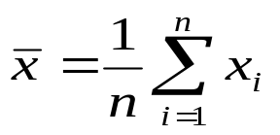

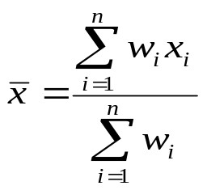
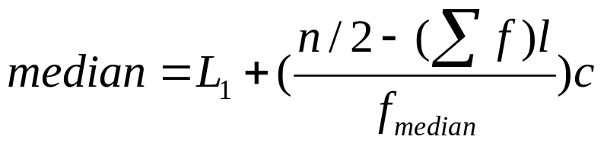
Measuring the Central Tendency
Mean (algebraic measure) (sample vs. population):
  Weighted arithmetic mean:
  Trimmed mean: chopping extreme values
Median: A holistic measure
  Middle value if odd number of values, or average of the middle two values otherwise
  Estimated by interpolation (for grouped data):
Mode
  Value that occurs most frequently in the data
  Unimodal, bimodal, trimodal
  Empirical formula:
Data Mining: Concepts and Techniques

Slide 12



Symmetric vs. Skewed Data
Median, mean and mode of symmetric, positively and negatively skewed data
Data Mining: Concepts and Techniques

Slide 13


Measuring the Dispersion of Data
Quartiles, outliers and boxplots
  Quartiles: Q₁ (25th percentile), Q₃ (75th percentile)
  Inter-quartile range: IQR = Q₃ – Q₁
  Five number summary: min, Q₁, M, Q₃, max
  Boxplot: ends of the box are the quartiles, median is marked, whiskers, and plot outlier individually
  Outlier: usually, a value higher/lower than 1.5 x IQR
Variance and standard deviation (sample: s, population: σ)
  Variance: (algebraic, scalable computation)
  Standard deviation s (or σ) is the square root of variance s² ⁽or σ²⁾
Data Mining: Concepts and Techniques

Slide 14
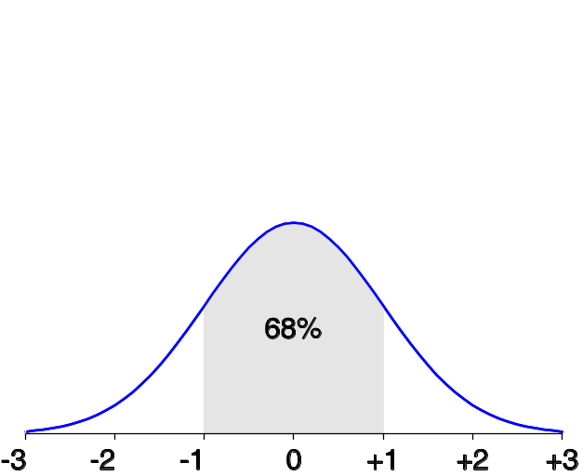
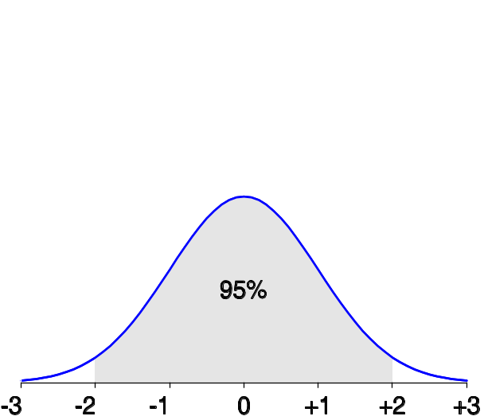
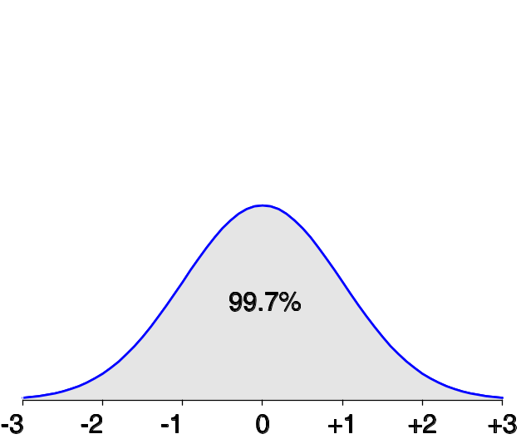
Properties of Normal Distribution Curve
The normal (distribution) curve
  From μ–σ to μ+σ: contains about 68% of the measurements (μ: mean, σ: standard deviation)
  From μ–2σ to μ+2σ: contains about 95% of it
  From μ–3σ to μ+3σ: contains about 99.7% of it
Data Mining: Concepts and Techniques

Slide 15

Boxplot Analysis
Five-number summary of a distribution:
  Minimum, Q1, M, Q3, Maximum
Boxplot
  Data is represented with a box
  The ends of the box are at the first and third quartiles, i.e., the height of the box is IRQ
  The median is marked by a line within the box
  Whiskers: two lines outside the box extend to Minimum and Maximum
Data Mining: Concepts and Techniques

Slide 16

Visualization of Data Dispersion: Boxplot Analysis
Data Mining: Concepts and Techniques

Slide 17

Histogram Analysis
Graph displays of basic statistical class descriptions
  Frequency histograms
    A univariate graphical method
    Consists of a set of rectangles that reflect the counts or frequencies of the classes present in the given data
Data Mining: Concepts and Techniques

Slide 18
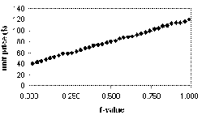
Quantile Plot
Displays all of the data (allowing the user to assess both the overall behavior and unusual occurrences)
Plots quantile information
  For a data x_{i} data sorted in increasing order, f_{i} indicates that approximately 100 f_{i}% of the data are below or equal to the value x_{i}
Data Mining: Concepts and Techniques

Slide 19
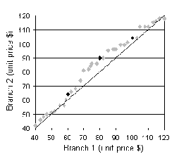
Quantile-Quantile (Q-Q) Plot
Graphs the quantiles of one univariate distribution against the corresponding quantiles of another
Allows the user to view whether there is a shift in going from one distribution to another
Data Mining: Concepts and Techniques

Slide 20
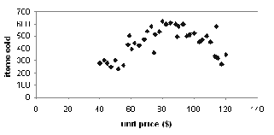
Scatter plot
Provides a first look at bivariate data to see clusters of points, outliers, etc
Each pair of values is treated as a pair of coordinates and plotted as points in the plane
Data Mining: Concepts and Techniques

Slide 21
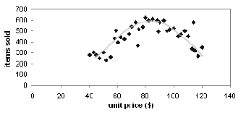
Loess Curve
Adds a smooth curve to a scatter plot in order to provide better perception of the pattern of dependence
Loess curve is fitted by setting two parameters: a smoothing parameter, and the degree of the polynomials that are fitted by the regression
Data Mining: Concepts and Techniques

Slide 22


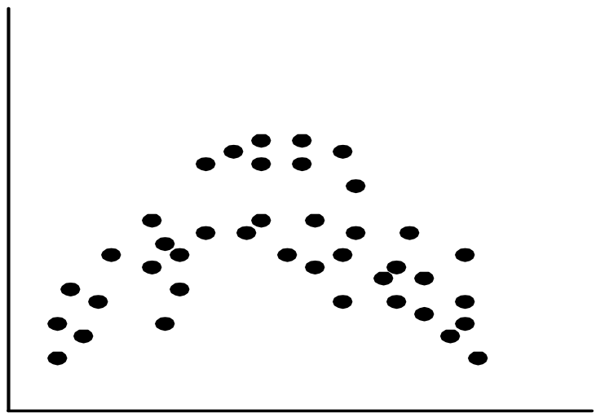
Positively and Negatively Correlated Data
Data Mining: Concepts and Techniques

Slide 23


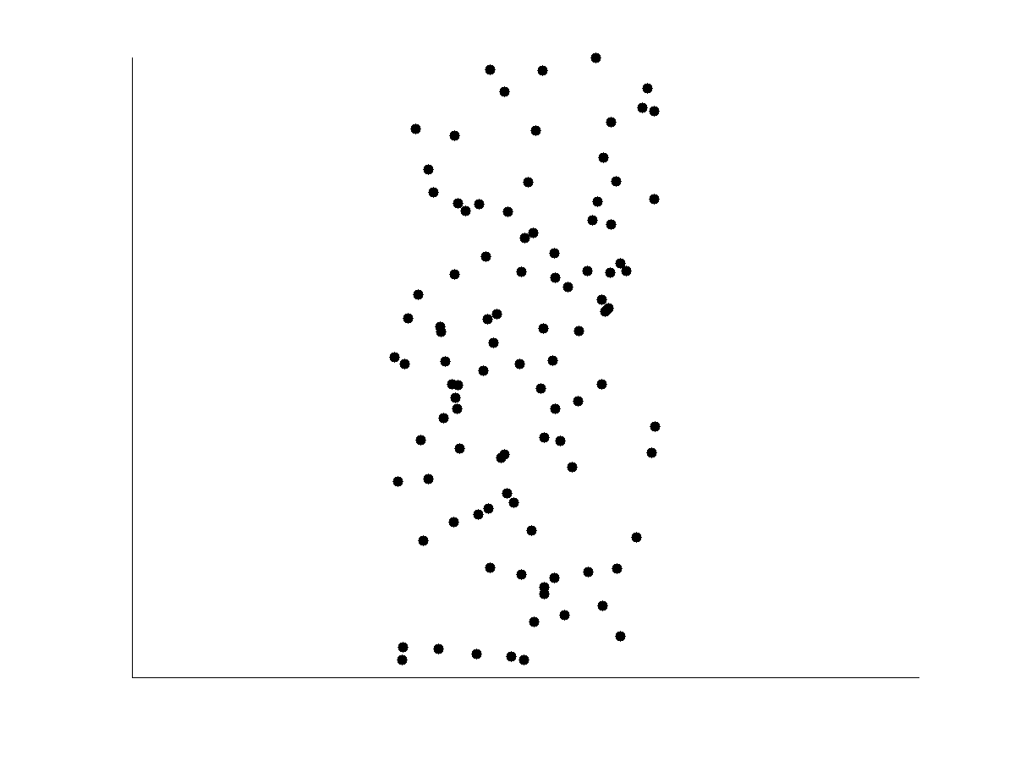
Not Correlated Data
Data Mining: Concepts and Techniques

Slide 24
Graphic Displays of Basic Statistical Descriptions
Histogram: (shown before)
Boxplot: (covered before)
Quantile plot: each value x_{i} is paired with f_{i} indicating that approximately 100 f_{i} % of data are ≤ x_{i}
Quantile-quantile (q-q) plot: graphs the quantiles of one univariant distribution against the corresponding quantiles of another
Scatter plot: each pair of values is a pair of coordinates and plotted as points in the plane
Loess (local regression) curve: add a smooth curve to a scatter plot to provide better perception of the pattern of dependence
Data Mining: Concepts and Techniques

Slide 25
Chapter 2: Data Preprocessing
Why preprocess the data?
Descriptive data summarization
Data cleaning
Data integration and transformation
Data reduction
Discretization and concept hierarchy generation
Summary
Data Mining: Concepts and Techniques

Slide 26
Data Cleaning
Importance
  “Data cleaning is one of the three biggest problems in data warehousing”—Ralph Kimball
  “Data cleaning is the number one problem in data warehousing”—DCI survey
Data cleaning tasks
  Fill in missing values
  Identify outliers and smooth out noisy data
  Correct inconsistent data
  Resolve redundancy caused by data integration
Data Mining: Concepts and Techniques

Slide 27
Missing Data
Data is not always available
  E.g., many tuples have no recorded value for several attributes, such as customer income in sales data
Missing data may be due to
  equipment malfunction
  inconsistent with other recorded data and thus deleted
  data not entered due to misunderstanding
  certain data may not be considered important at the time of entry
  not register history or changes of the data
Missing data may need to be inferred.
Data Mining: Concepts and Techniques

Slide 28
How to Handle Missing Data?
Ignore the tuple: usually done when class label is missing (assuming the tasks in classification—not effective when the percentage of missing values per attribute varies considerably.
Fill in the missing value manually: tedious + infeasible?
Fill in it automatically with
  a global constant : e.g., “unknown”, a new class?!
  the attribute mean
  the attribute mean for all samples belonging to the same class: smarter
  the most probable value: inference-based such as Bayesian formula or decision tree
Data Mining: Concepts and Techniques

Slide 29
Noisy Data
Noise: random error or variance in a measured variable
Incorrect attribute values may due to
  faulty data collection instruments
  data entry problems
  data transmission problems
  technology limitation
  inconsistency in naming convention
Other data problems which requires data cleaning
  duplicate records
  incomplete data
  inconsistent data
Data Mining: Concepts and Techniques

Slide 30
How to Handle Noisy Data?
Binning
  first sort data and partition into (equal-frequency) bins
  then one can smooth by bin means, smooth by bin median, smooth by bin boundaries, etc.
Regression
  smooth by fitting the data into regression functions
Clustering
  detect and remove outliers
Combined computer and human inspection
  detect suspicious values and check by human (e.g., deal with possible outliers)
Data Mining: Concepts and Techniques

Slide 31
Simple Discretization Methods: Binning
Equal-width (distance) partitioning
  Divides the range into N intervals of equal size: uniform grid
  if A and B are the lowest and highest values of the attribute, the width of intervals will be: W = (B –A)/N.
  The most straightforward, but outliers may dominate presentation
  Skewed data is not handled well
Equal-depth (frequency) partitioning
  Divides the range into N intervals, each containing approximately same number of samples
  Good data scaling
  Managing categorical attributes can be tricky
Data Mining: Concepts and Techniques

Slide 32
Binning Methods for Data Smoothing
Sorted data for price (in dollars): 4, 8, 9, 15, 21, 21, 24, 25, 26, 28, 29, 34
* Partition into equal-frequency (equi-depth) bins:
- Bin 1: 4, 8, 9, 15
- Bin 2: 21, 21, 24, 25
- Bin 3: 26, 28, 29, 34
* Smoothing by bin means:
- Bin 1: 9, 9, 9, 9
- Bin 2: 23, 23, 23, 23
- Bin 3: 29, 29, 29, 29
Data Mining: Concepts and Techniques

Slide 33
Data Cleaning as a Process
Data discrepancy detection
  Use metadata (e.g., domain, range, dependency, distribution)
  Check field overloading
  Check uniqueness rule, consecutive rule and null rule
  Use commercial tools
    Data scrubbing: use simple domain knowledge (e.g., postal code, spell-check) to detect errors and make corrections
    Data auditing: by analyzing data to discover rules and relationship to detect violators (e.g., correlation and clustering to find outliers)
Data migration and integration
  Data migration tools: allow transformations to be specified
  ETL (Extraction/Transformation/Loading) tools: allow users to specify transformations through a graphical user interface
Integration of the two processes
  Iterative and interactive (e.g., Potter’s Wheels)
Data Mining: Concepts and Techniques

Slide 34
Chapter 2: Data Preprocessing
Why preprocess the data?
Data cleaning
Data integration and transformation
Data reduction
Discretization and concept hierarchy generation
Summary
Data Mining: Concepts and Techniques

Slide 35
Data Integration
Data integration:
  Combines data from multiple sources into a coherent store
Schema integration: e.g., A.cust-id ≡ B.cust-#
  Integrate metadata from different sources
Entity identification problem:
  Identify real world entities from multiple data sources, e.g., Bill Clinton = William Clinton
Detecting and resolving data value conflicts
  For the same real world entity, attribute values from different sources are different
  Possible reasons: different representations, different scales, e.g., metric vs. British units
Data Mining: Concepts and Techniques

Slide 36
Handling Redundancy in Data Integration
Redundant data occur often when integration of multiple databases
  Object identification: The same attribute or object may have different names in different databases
  Derivable data: One attribute may be a “derived” attribute in another table, e.g., annual revenue
Redundant attributes may be able to be detected by correlation analysis
Careful integration of the data from multiple sources may help reduce/avoid redundancies and inconsistencies and improve mining speed and quality
Data Mining: Concepts and Techniques

Slide 37

Correlation Analysis (Categorical Data)
Χ² (chi-square) test
The larger the Χ² value, the more likely the variables are related
The cells that contribute the most to the Χ² value are those whose actual count is very different from the expected count
Correlation does not imply causality
  # of hospitals and # of car-theft in a city are correlated
  Both are causally linked to the third variable: population
Data Mining: Concepts and Techniques

Slide 38
Chi-Square Calculation: An Example
Χ² (chi-square) calculation (numbers in parenthesis are expected counts calculated based on the data distribution in the two categories)
It shows that like_science_fiction and play_chess are correlated in the group
 | Play chess | Not play chess | Sum (row)
Like science fiction | 250(90) | 200(360) | 450
Not like science fiction | 50(210) | 1000(840) | 1050
Sum(col.) | 300 | 1200 | 1500
Data Mining: Concepts and Techniques

Slide 39
Data Transformation
Smoothing: remove noise from data
Aggregation: summarization, data cube construction
Generalization: concept hierarchy climbing
Normalization: scaled to fall within a small, specified range
  min-max normalization
  z-score normalization
  normalization by decimal scaling
Attribute/feature construction
  New attributes constructed from the given ones
Data Mining: Concepts and Techniques

Slide 40
The difference between data cleansing and data transformation is that the data cleansing is the process of removing unwanted data from a dataset or database while the data transformation is the process of converting data from one format to another format.
Data Mining: Concepts and Techniques

Slide 41
What is the difference between data cleaning and data wrangling?
Data cleaning focuses on removing erroneous data from your data set. In contrast, data-wrangling focuses on changing the data format by translating "raw" data into a more usable form
Data Mining: Concepts and Techniques

Slide 42
What is data transformation?
Data transformation is the process of converting data from one format, such as a database file, XML document or Excel spreadsheet, into another. Transformations typically involve converting a raw data source into a cleansed, validated and ready-to-use format.
Data Mining: Concepts and Techniques

Slide 43
Data merging is the process of combining two or more similar records into a single one. Merging is done to add variables to a dataset, append or add cases or observations to a dataset, or remove duplicates and other incorrect information.
Data Mining: Concepts and Techniques

Slide 44
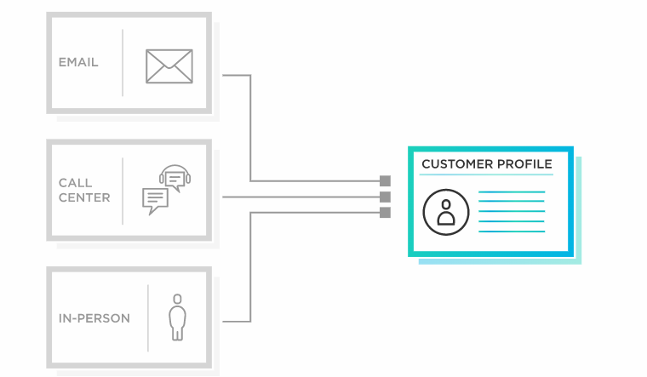
Data Merging
Data Mining: Concepts and Techniques

Slide 45
Data transformation is the process of converting data from one format to another, typically from the format of a source system into the required format of a destination system.
Data transformation is a component of most data integration and data management tasks, such as data wrangling and data warehousing.
Data Mining: Concepts and Techniques

Slide 46
Frequent Patterns mining
Frequent patterns are itemsets, subsequences, or substructures that appear in a data set with frequency no less than a user-specified threshold.
For example, a set of items, such as milk and bread, that appear frequently together in a transaction data set, is a frequent itemset.
A subsequence, such as buying first a PC, then a digital camera, and then a memory card, if it occurs frequently in a shopping history database, is a (frequent) sequential pattern.
Data Mining: Concepts and Techniques

Slide 47
A substructure can refer to different structural forms, such as subgraphs, subtrees, or sublattices, which may be combined with itemsets or subsequences.
If a substructure occurs frequently in a graph database, it is called a (frequent) structural pattern.
Finding frequent patterns plays an essential role in mining associations, correlations, and many other interesting relationships among data.
Data Mining: Concepts and Techniques

Slide 48
Frequent Pattern Mining is a Data Mining subject with the objective of extracting frequent itemsets from a database.
Frequent itemsets play an essential role in many Data Mining tasks and are related to interesting patterns in data, such as Association Rules.
Data Mining: Concepts and Techniques

Slide 49
Associations and Correlations,
Technically, association refers to any relationship between two variables, whereas correlation is often used to refer only to a linear relationship between two variables. The terms are used interchangeably in this guide, as is common in most statistics texts. A scatter plot shows the association between two variables
Data Mining: Concepts and Techniques

Slide 50
Are Association and correlation analysis equivalent?
No; correlation is not equivalent to association. However, the meaning of correlation is dependent upon context. The classical statistics definition is, to quote from Kotz and Johnson's Encyclopedia of Statistical Sciences "a measure of the strength of of the linear relationship between two random variable
Data Mining: Concepts and Techniques

Slide 51
Correlation is measured by a correlation coefficient, and requires that there is an association between two variables, but association does not imply correlation.
Correlation determines whether a relationship exists between two variables. If an increase in the first variable, x, always brings the same increase in the second variable,y, then the correlation value would be +1.0.
Data Mining: Concepts and Techniques

Slide 52
Depending on the context, you could be using a diagram (like a scatter plot) to show an association between variables or using a hypothesis test to demonstrate statistically that relationships exist between variables. A bivariate association test involves one independent variable and one dependent variable.
Data Mining: Concepts and Techniques

Slide 53
Apriori algorithm
Apriori algorithm refers to the algorithm which is used to calculate the association rules between objects.
It means how two or more objects are related to one another.
In other words, we can say that the apriori algorithm is an association rule leaning that analyzes that people who bought product A also bought product B.
Data Mining: Concepts and Techniques

Slide 54
The primary objective of the apriori algorithm is to create the association rule between different objects.
The association rule describes how two or more objects are related to one another. Apriori algorithm is also called frequent pattern mining.
Data Mining: Concepts and Techniques

Slide 55
We take an example to understand the concept better.
You must have noticed that the Pizza shop seller makes a pizza, soft drink, and breadstick combo together. He also offers a discount to their customers who buy these combos.
Do you ever think why does he do so? He thinks that customers who buy pizza also buy soft drinks and breadsticks.
However, by making combos, he makes it easy for the customers. At the same time, he also increases his sales performance.
Data Mining: Concepts and Techniques

Slide 56
What is Apriori Algorithm?
Apriori algorithm refers to an algorithm that is used in mining frequent products sets and relevant association rules.
Generally, the apriori algorithm operates on a database containing a huge number of transactions.
Apriori algorithm helps the customers to buy their products with ease and increases the sales performance of the particular store.
Data Mining: Concepts and Techniques

Slide 57
Components of Apriori algorithm
The given three components comprise the apriori algorithm.
Support
Confidence
Lift
Data Mining: Concepts and Techniques

Slide 58
Let's take an example to understand this concept.
We have already discussed above; you need a huge database containing a large no of transactions. Suppose you have 4000 customers transactions in a Big Bazar. You have to calculate the Support, Confidence, and Lift for two products, and you may say Biscuits and Chocolate. This is because customers frequently buy these two items together.
Out of 4000 transactions, 400 contain Biscuits, whereas 600 contain Chocolate, and these 600 transactions include a 200 that includes Biscuits and chocolates. Using this data, we will find out the support, confidence, and lift.
Data Mining: Concepts and Techniques

Slide 59
Support
Support refers to the default popularity of any product. You find the support as a quotient of the division of the number of transactions comprising that product by the total number of transactions. Hence, we get
Support (Biscuits) = (Transactions relating biscuits) / (Total transactions)
= 400/4000 = 10 percent.
Data Mining: Concepts and Techniques

Slide 60
Confidence
Confidence refers to the possibility that the customers bought both biscuits and chocolates together. So, you need to divide the number of transactions that comprise both biscuits and chocolates by the total number of transactions to get the confidence.
Hence,
Confidence = (Transactions relating both biscuits and Chocolate) / (Total transactions involving Biscuits)
Data Mining: Concepts and Techniques

Slide 61
= 200/400
= 50 percent.
It means that 50 percent of customers who bought biscuits bought chocolates also.
Data Mining: Concepts and Techniques

Slide 62
Lift
Consider the above example; lift refers to the increase in the ratio of the sale of chocolates when you sell biscuits. The mathematical equations of lift are given below.
Lift = (Confidence (Biscuits - chocolates)/ (Support (Biscuits)
= 50/10 = 5
It means that the probability of people buying both biscuits and chocolates together is five times more than that of purchasing the biscuits alone. If the lift value is below one, it requires that the people are unlikely to buy both the items together. Larger the value, the better is the combination.
Data Mining: Concepts and Techniques

Slide 63
How does the Apriori Algorithm work in Data Mining?
Do yourself
Data Mining: Concepts and Techniques

